Slide 1
Command pattern
Khaled Elnaggar

Slide 2
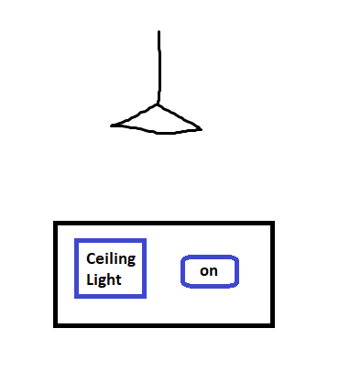
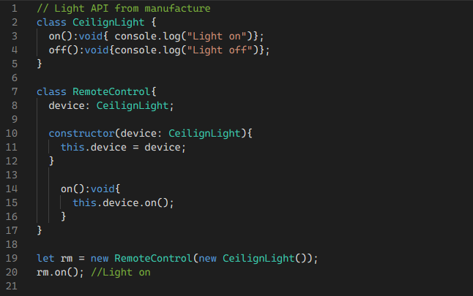
Smart home

Slide 3
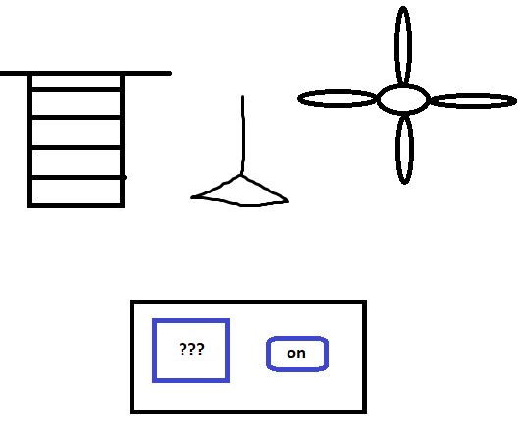
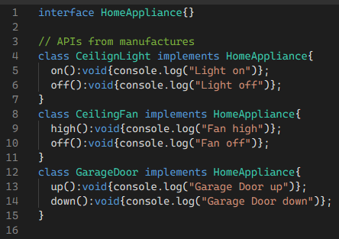
Smart home

Slide 4
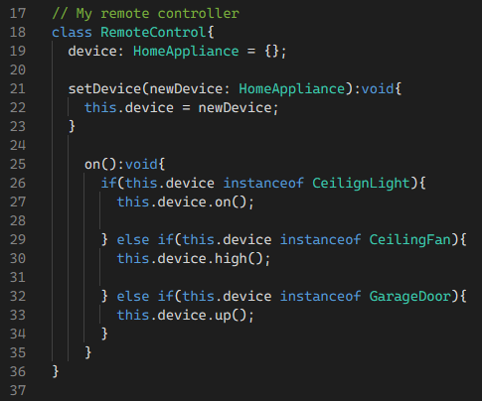
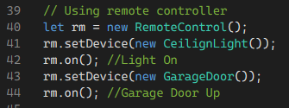
Smart home

Slide 5
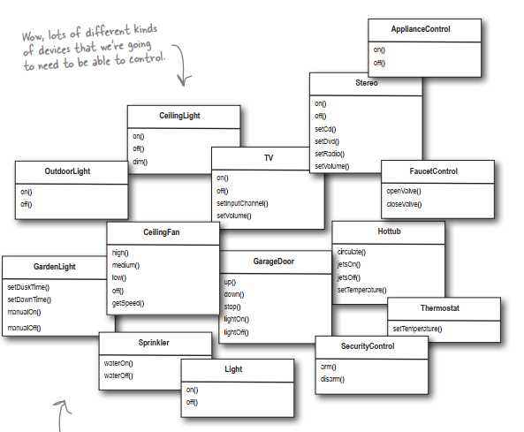
Smart home

Slide 6
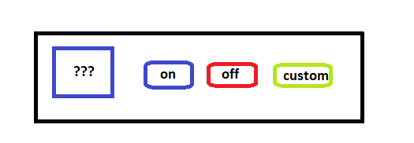
Smart home
Code is tightly coupled and not maintainable
Need to separate action request (invoker) from action processing (receiver)

Slide 7
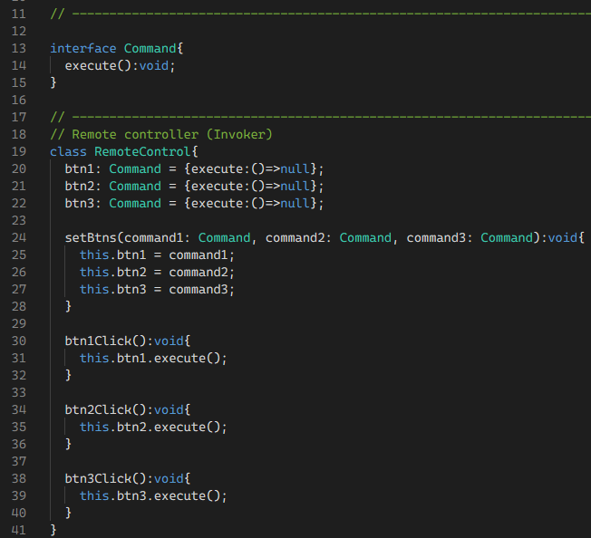
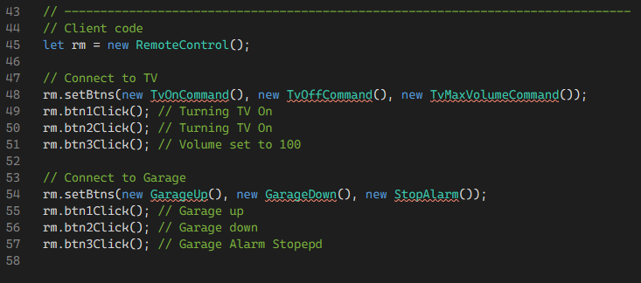

Slide 8
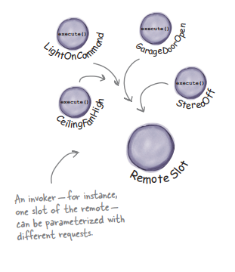
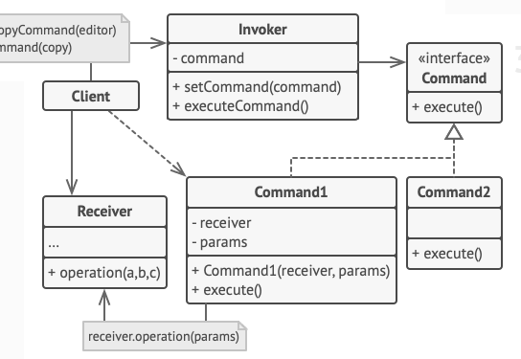

Slide 9
Smart home
Code is modular
Supports open closed principle

Slide 10

Questions
Headfirst design patterns
Demo 1
Demo 2

